Slide 1
BE ST RMWATER SMART
Invest in Solutions to Improve Our Community
Notes:
NOTE: THIS PRESENTATION IS MEANT TO BE CUSTOMIZED BY A COMMUNITY; ITEMS IN BRACKETS ARE MEANT TO BE FILLED IN WITH LOCAL INFORMATION, AND PHOTOS CAN BE REPLACED WITH LOCAL ONES. IT IS DESIGNED FOR AN AUDIENCE OF MUNICIPAL OFFICIALS AND DECISIONMAKERS; THEREFORE, THE CONTENT IS NOT GEARED TOWARDS A GENERAL PUBLIC AUDIENCE.

Slide 2
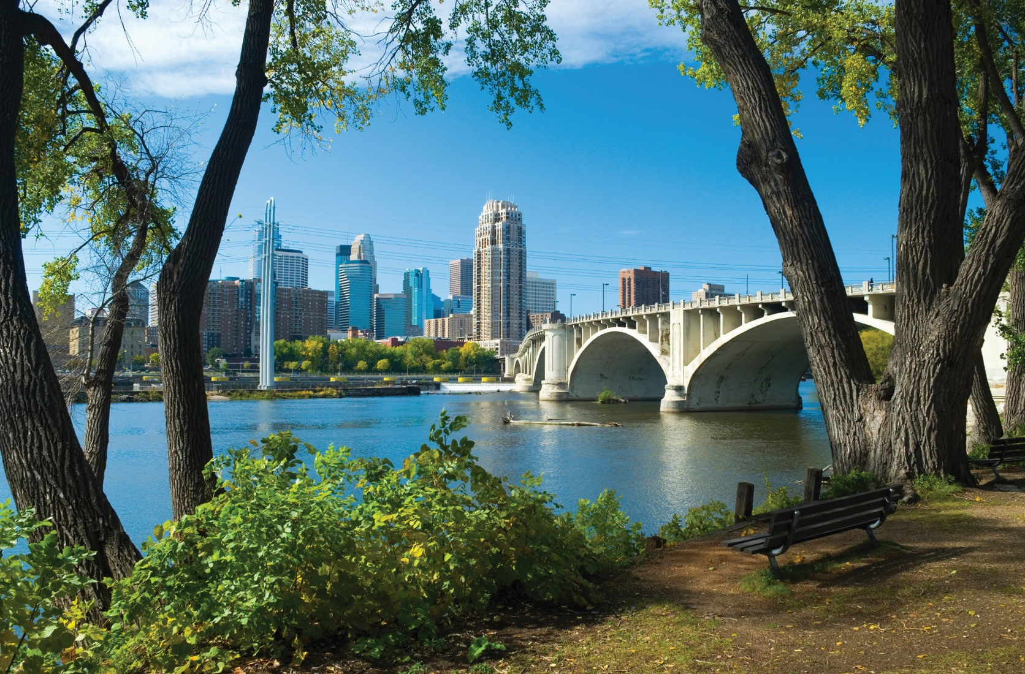
Improving Our Community
Clean rivers, lakes, and streams are vital to the health of our community and economy.
Notes:
[Insert the name of your local water body(ies)] is/are important to our community. [List reasons why the river, lake, stream, etc. is important, from water supplies and transportation to recreation or tourism.]
That’s why I’d like to talk about stormwater management and why investing in it can help enhance the health of our local waterways and our citizens.
NOTE: REPLACE THE PHOTO WITH ONE OF YOUR COMMUNITY WATERWAYS

Slide 3
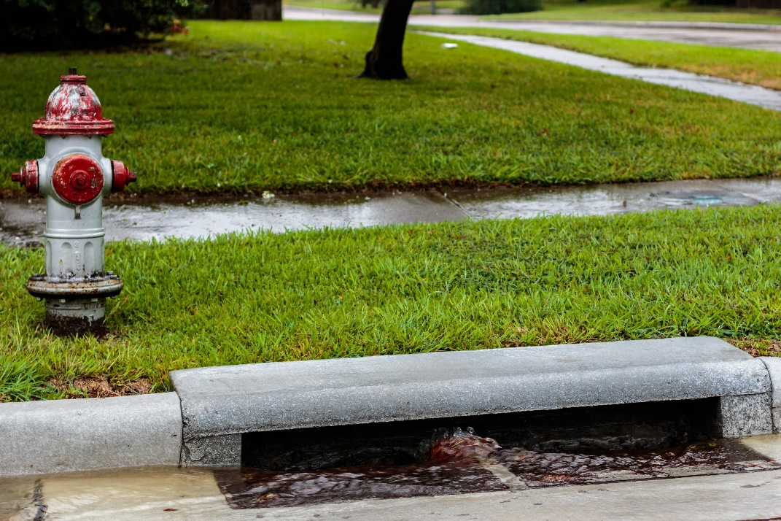
Stormwater 101
Stormwater is water from rain and snow that can pick up pollutants as it flows over surfaces such as roads, sidewalks, buildings, and landscapes.
Notes:
Stormwater that is not absorbed into the ground picks up pollutants, such as dirt and loose sediment, gasoline and oil, and other chemicals and debris, as it flows into storm drains and down to [name of local waterway(s)], bringing pollution with it.
Managing stormwater appropriately is vital to the health of waterways, our community, and our quality of life.
NOTE: REPLACE THE PHOTO WITH ONE OF YOUR COMMUNITY STORM DRAINS

Slide 4
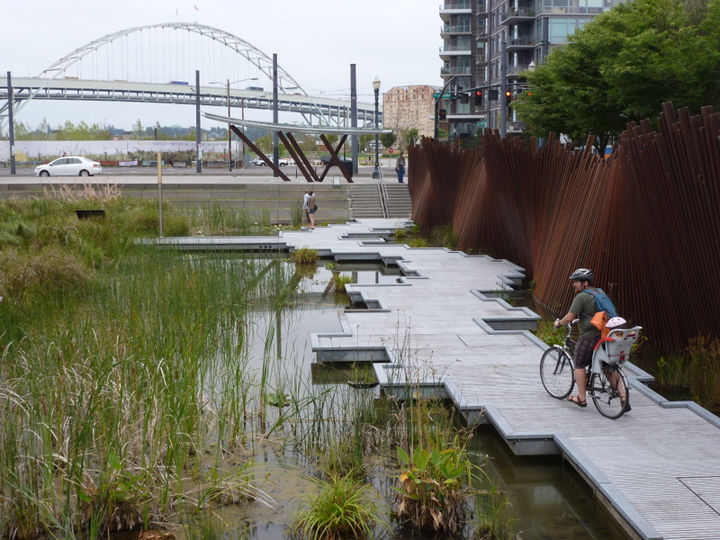
Why Care About Stormwater?
MS4 communities such as ours are required to implement a program that continually improves stormwater management.
Notes:
[CITY NAME] has what’s called an “MS4.” A Municipal Separate Storm Sewer System (MS4) is a publicly-owned system that collects and transports only stormwater via pipes and channels.
MS4s do not send stormwater runoff to a wastewater treatment plant.
Stormwater collected in the MS4 is discharged directly into streams, lakes, rivers, and ponds.
We have coverage under an MS4 permit that allows our MS4 to discharge stormwater into our water bodies.
Our MS4 permit requires that we comply with a variety of measures that contribute to reducing polluted runoff and improving our stormwater management.
NOTE: REPLACE THE PHOTO WITH ONE OF YOUR COMMUNITY’S STORMWATER SYSTEM

Slide 5
What We Currently Do
List/show how you currently manage stormwater in your area
Notes:
INSERT TEXT EXPLAINING HOW STORMWATER IS CURRENTLY MANAGED IN YOUR COMMUNITY. WHAT ARE THE COMMON MANAGEMENT PRACTICES? IS GREEN INFRASTRUCTURE INSTALLED? WHAT TYPE OF MAINTENANCE PROGRAM IS IN PLACE?

Slide 6

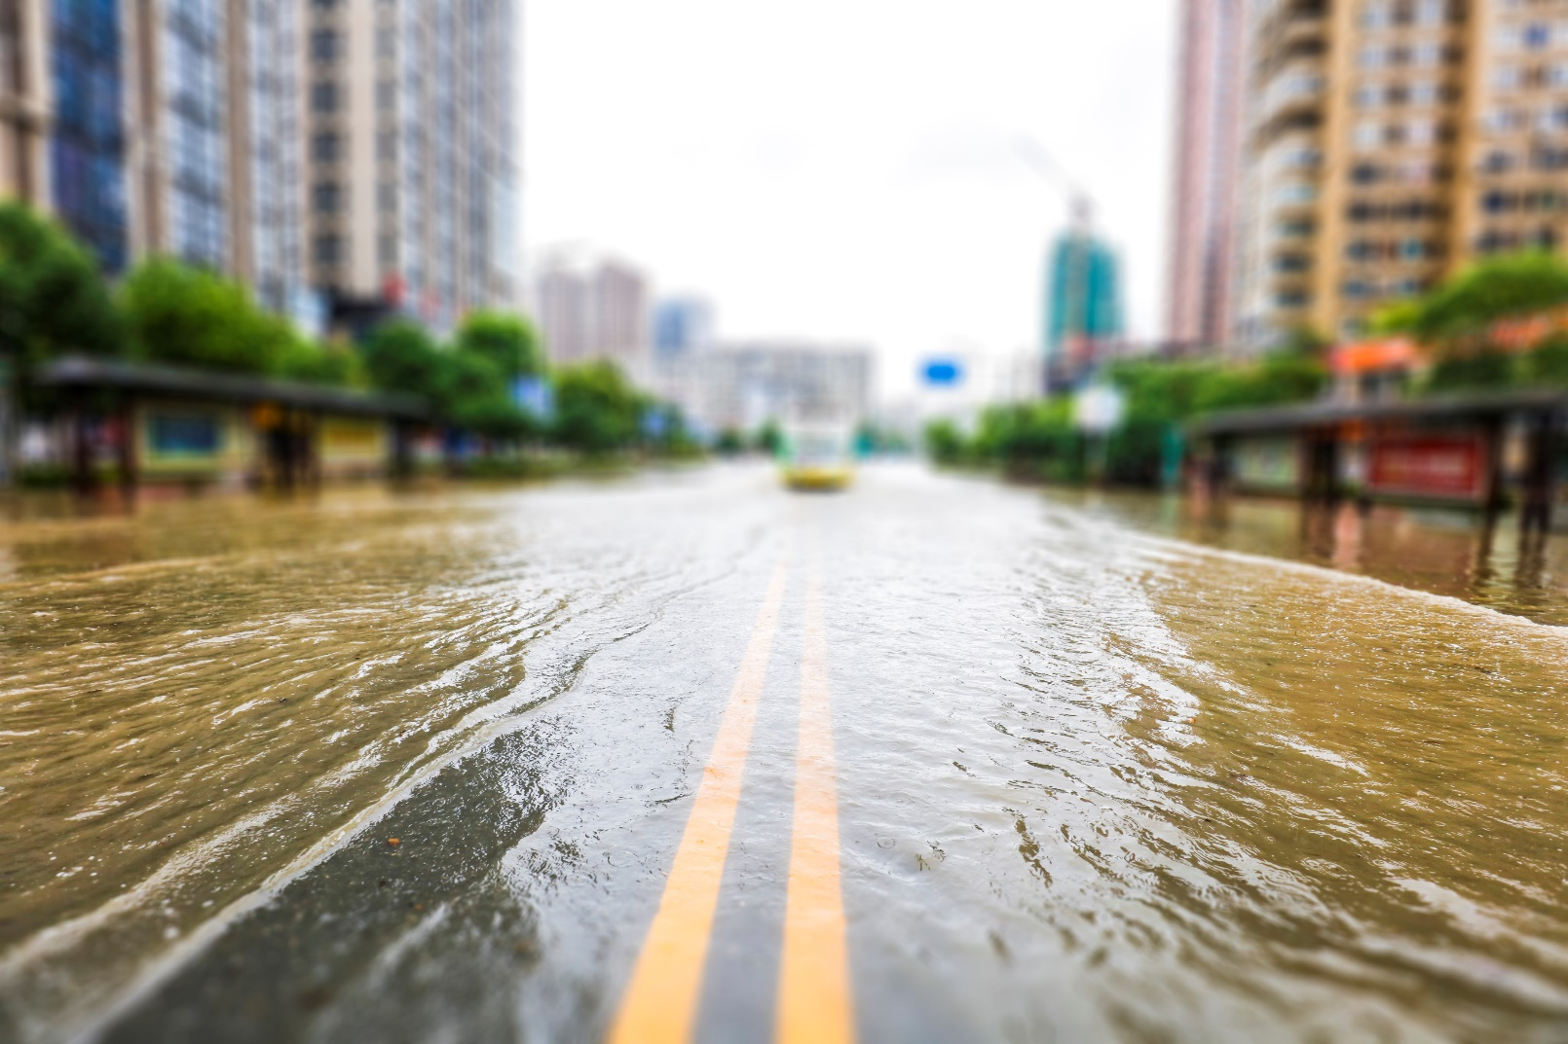
Costs to the Community if We Don’t Manage Stormwater Better
Increased flooding
Infrastructure and property damage
Polluted waterways
Permit non-compliance
Notes:
The cost of not managing stormwater could be much higher than investing in stormwater management.
These problems often mean we need to spend more money to fix the impacts of stormwater in our community.
NOTE: REPLACE THE PHOTO IF YOU HAD ANY FLOODING IN YOUR COMMUNITY AND CUSTOMIZE WITH COSTS SPECIFIC TO YOUR COMMUNITY (e.g., habitat destruction, closed roads and bridges, business closures from flooding)

Slide 7
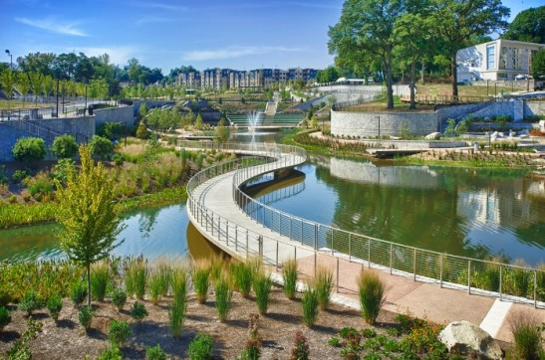
Stormwater Management Benefits
Reduces and prevents pollution
Avoids fines and keeps money for local projects
Enhances the community
Aligns with our community goals
  Protecting public health
  [insert other goals]
Notes:
Managing our stormwater will improve the quality of our rivers, lakes, and streams.
It also helps us meet the requirements of our MS4 permit and avoid fines.
Adequately managing our stormwater provides these direct benefits to our residents:
Filters pollutants, helps minimize flooding, improves aesthetics, and increases the flow of water into the ground that recharges water supplies.
Improves natural habitats, which promotes community growth and supports local jobs, tourism, and recreation.
Creates more green spaces—which encourages physical activity, reduces noise pollution, and helps regulate temperatures in urban areas.
Implementing good stormwater management also aligns with our broader community economic and public health goals.
NOTE: REPLACE THE PHOTO WITH ONE OF YOUR COMMUNITY WATERWAYS/RECREATION AREAS AND INSERT RELATED COMMUNITY GOALS

Slide 8
Stormwater Smart Solutions
It’s time to make a smart investment in our community:
Green infrastructure
Detention pond maintenance and retrofits
Additional green spaces and fewer hard surfaces
Pipe repair and infrastructure improvements
Code or ordinance updates
Improved stormwater inspections
Community outreach and municipal staff training
Notes:
EDIT THIS LIST TO FIT YOUR COMMUNITY/ADD DETAILS OF YOUR SPECIFIC COMMUNITY STORMWATER MANAGEMENT NEEDS. THE FOLLOWING SLIDES FOCUS ON GREEN INFRASTRUCTURE INVESTMENT. INCLUDE ADDITIONAL SLIDES ABOUT ANY OF THE SOLUTIONS LISTED HERE THAT ARE RELEVANT TO YOUR COMMUNITY.
INSERT ADDITIONAL SLIDES AS NEEDED TO DESCRIBE SPECIFIC STORMWATER SOLUTIONS/NEEDS IN THE COMMUNITY.

Slide 9
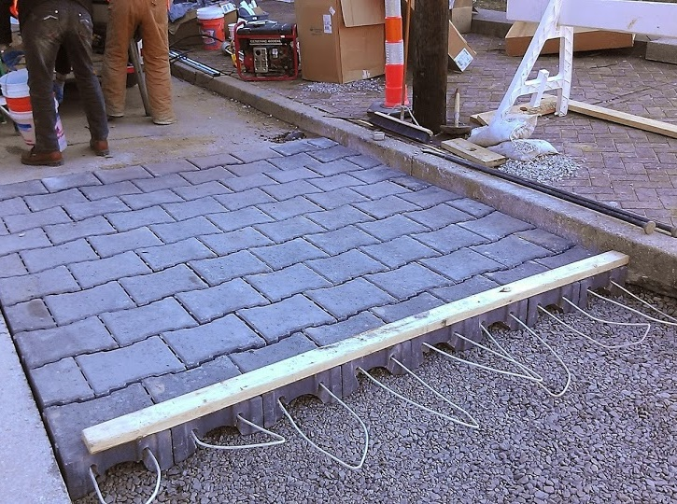
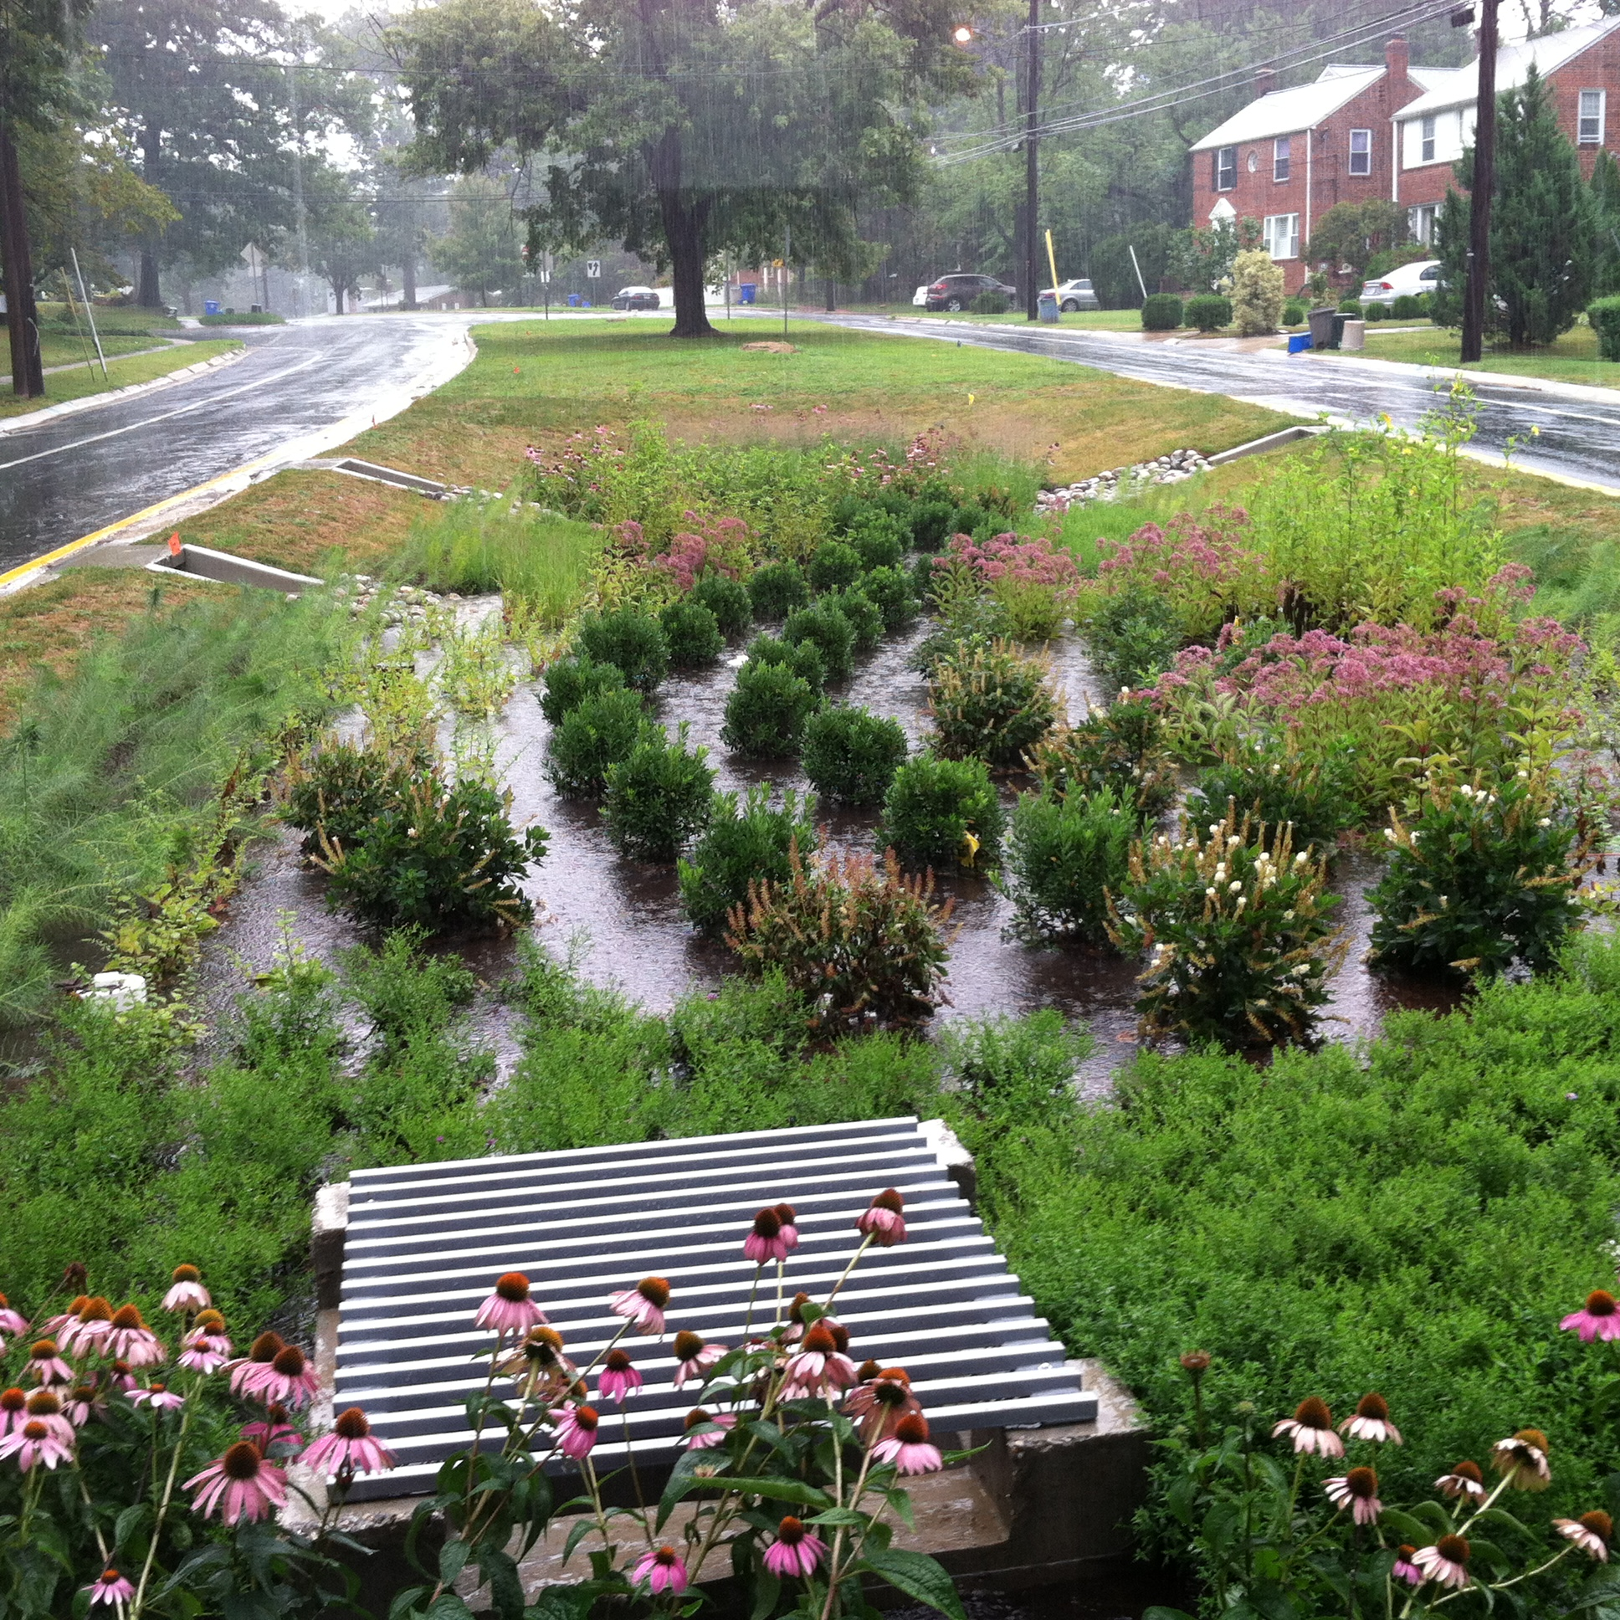
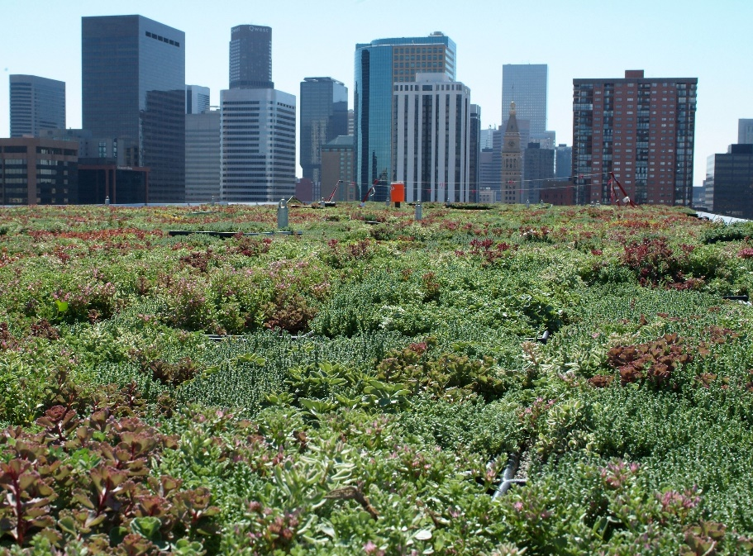
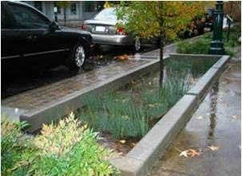
Green Infrastructure
Green infrastructure reduces and treats stormwater before it discharges pollutants to surface waters.
Permeable Pavement
Bioretention Areas
Green Roofs
Planter Boxes
Notes:
Green infrastructure is a type of stormwater management that mimics the natural water cycle and helps reduce pollution while providing environmental, social, and economic benefits.
Some common examples of green infrastructure include permeable pavement, bioretention areas, green roofs, and planter boxes.
Green infrastructure provides more benefits compared to gray stormwater infrastructure (such as detention ponds and conventional piped drainage).
Gray stormwater infrastructure tends to be single purpose, meaning that its primary focus is to move stormwater away from where it lands, whereas green infrastructure manages stormwater AND provides ancillary benefits to the community.

Slide 10
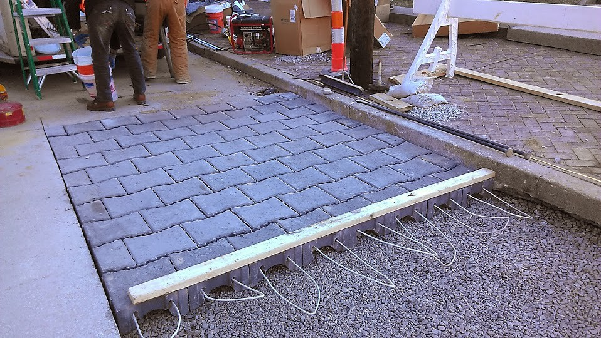
Permeable Pavement
Permeable pavements help treat and store stormwater where rain or snow falls.
Notes:
As an alternative to traditional pavement, permeable pavement allows rainwater and melting snow to seep through the surface to underlying layers of soil and gravel.
Permeable pavement can be made of pervious concrete, porous asphalt, or permeable interlocking pavers.
This type of green infrastructure practice can be cost-effective where land values are high.
It can also help reduce flooding or icing of water at the pavement surface.

Slide 11
Bioretention Areas
These engineered green areas mimic the natural movement of water and can be installed in almost any unpaved space to collect runoff.
Notes:
A bioretention area is a sunken area in the landscape that collects rainwater from rooftops, sidewalks, and streets. They often consist of different varieties of vegetation, grasses, and perennial flowers.
Bioretention areas are designed to allow water to pond when it rains and then either soak into the ground or flow through an underdrain.
A rain garden is very similar to a bioretention, but it is less engineered. Rain gardens are typically small, do not have underdrains, and are associated with residences. Like bioretention areas, rain gardens also collect rainwater in a shallow depression and allow it to soak into the ground.
Bioretention areas are a green infrastructure practice that can help solve drainage problems and improve water quality.

Slide 12
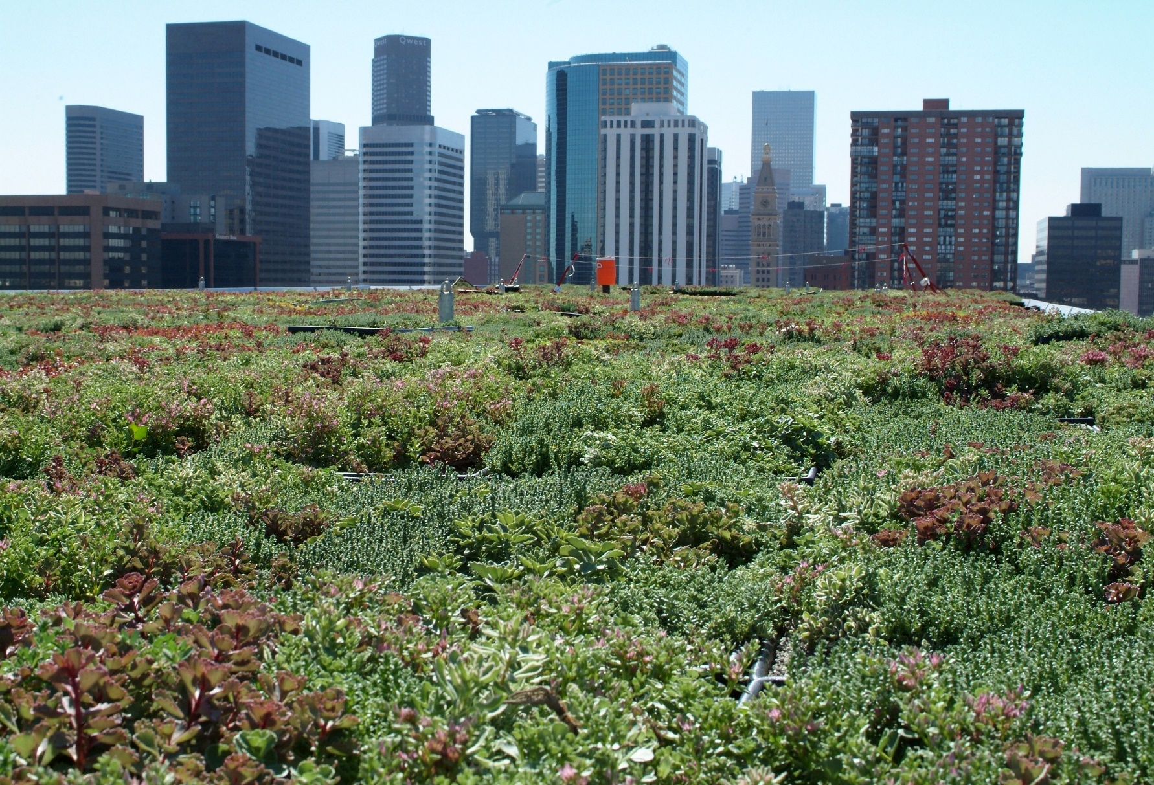
Green Roofs
Green roofs—roofs covered with trees, plants, and groundcover —reduce the water that flows off roofs after a storm.
Notes:
Often used in city environments, green roofs are layers of vegetation planted over a waterproofing system installed on top of a building roof. Green roofs allow the water from rain and snow to filter into the plants and vegetation on the roof rather than flowing off the impermeable surface of the roof onto the sidewalks and streets below.
Green roofs absorb water like a sponge, then release it through evaporation and plant use. This type of roof can drastically decrease the amount of rainwater that would otherwise fall into storm drains as stormwater. It also reduces the “urban heat island” effect, which causes buildings to use more energy for cooling.
Green roofs are particularly cost-effective in dense urban areas where land values are high and on large industrial or office buildings where they can help improve a roof’s longevity.

Slide 13
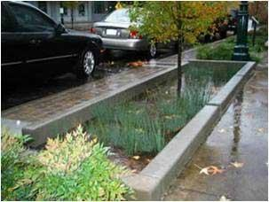
Planter Boxes
Planter boxes allow rain to soak in naturally and are best suited for sidewalks, parking lots, streets, and medians.
Notes:
Planter boxes provide an attractive option for city green spaces; they are also able to absorb runoff from sidewalks, parking lots, and streets.
Planter boxes are ideal for space-limited sidewalks, in parking lots, and as a streetscaping element.

Slide 14
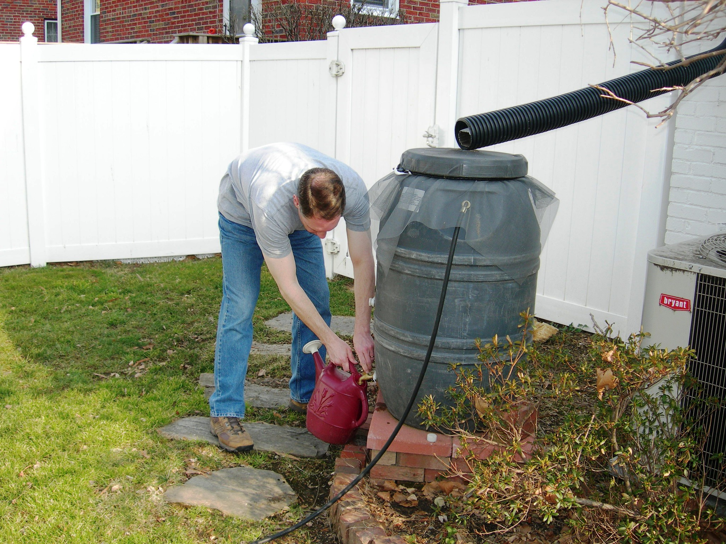
Residential Programs
Encourage and incentivize community members to manage stormwater and install green infrastructure in their own back yards
Programs may focus on activities such as planting trees or building and installing rain barrels and rain gardens
Photo credit: https://www.flickr.com/photos/arlingtonva/4898729362
Notes:
Green infrastructure residential programs are a mechanism that communities can use to help encourage residents to contribute to the community’s stormwater management goals.
Programs may focus on a variety of activities that community members can do at their own properties such as planting trees or building and installing rain barrels or rain gardens.
Some programs even provide financial incentives if residents install and maintain green infrastructure on their properties.
Residential programs are a great way to get people involved and invested in stormwater management at the local scale.

Slide 15
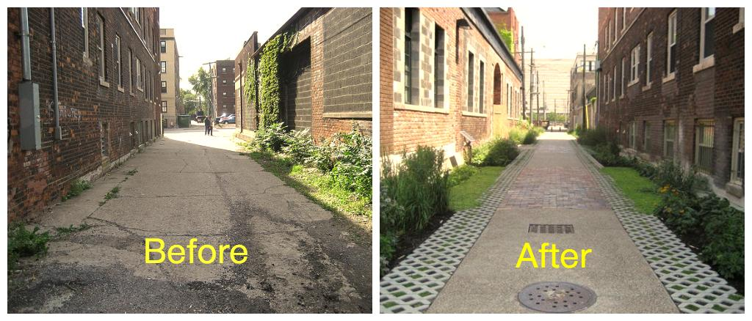
Case Study: Detroit, MI
Neglected alleys transformed into walkways that are attractive and stormwater smart.
Photo credit: https://www.patronicity.com/project/greenalley#!/
Notes:
The city of Detroit’s Green Alley Program has installed rain gardens, permeable pavement, and native landscaping to help improve the condition of alleys and to reduce polluted stormwater.

Slide 16
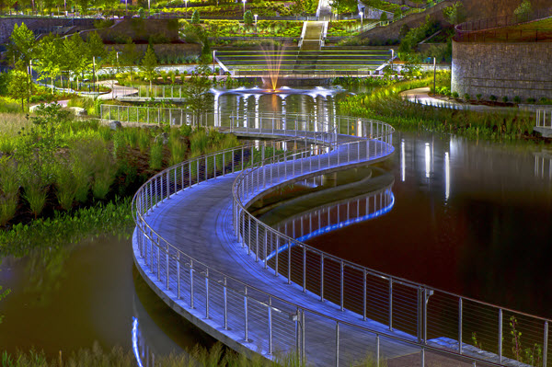
Case Study: Atlanta, GA
The historic Fourth Ward Park provides numerous community benefits while managing stormwater.
Photo credit: https://www.asce.org/templates/sustainability-profile.aspx?id=24439
Notes:
This 17-acre historic park in Atlanta was designed through a partnership among residents, business stakeholders, and the local government.
A large detention pond is surrounded by walking trails, urban plazas, a splash pad, native plantings, and an amphitheater that can be enjoyed by residents.
Water from the pond is even used to water the park's lawns and playing fields.
The detention provided by the pond has reduced combined sewer overflow events, and the surrounding area has experienced dramatically reduced flooding because of the improved stormwater management.
The project has also generated adjacent development and revitalization.
Photo credit: https://www.asce.org/templates/sustainability-profile.aspx?id=24439

Slide 17
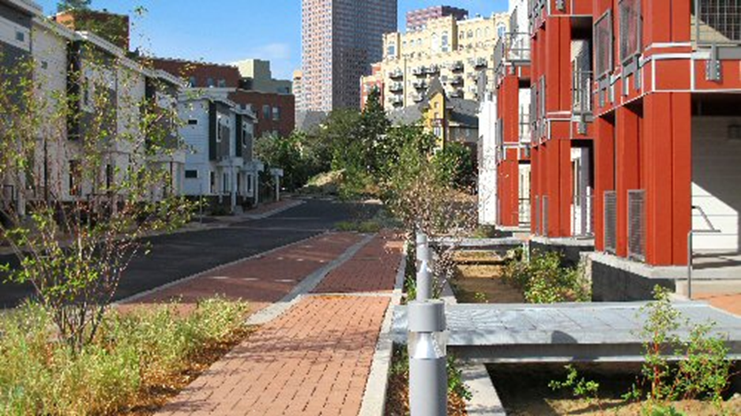
Case Study: Denver, CO
The Denver Housing Authority has installed green infrastructure to help reduce stormwater-related costs.
https://www.epa.gov/green-infrastructure/green-infrastructure-semi-arid-west
Notes:
The Denver Housing Authority installed rain gardens and permeable pavement to make its Park Avenue development environmentally sound and attractive.
By using green infrastructure, the Authority decreased the project’s stormwater infrastructure costs from $850,000 (stormwater vault) to $350,000 (bioswales and permeable pavements) at its Park Avenue site.

Slide 18
Our Stormwater Successes
Insert photo and project benefits.
Notes:
HAVE A SUCCESSFUL LOCAL EXAMPLE TO HIGHLIGHT? INSERT IT HERE!

Slide 19
To Ensure Future Success
It’s time to invest in stormwater smart solutions
  Insert potential project(s)
  Discuss future need
Our success relies on
  Partners
  Funding
  Long-term commitment
  Planning
Notes:
HERE’S THE PLACE TO MAKE THE ASK; TAILOR THIS SLIDE AS APPROPRIATE,

Slide 20
Possible Partners
Riverkeepers or other environmental groups
Schools or religious organizations
Recreational organizations
Homeowner or civic organizations
Recreational groups
Chamber of Commerce
Financial institutions
Notes:
Update/personalize this list to fit your community
Riverkeeper alliances or other local environmental groups
Area schools or religious organizations
Recreational organizations
Homeowner associations or civic organizations
Chamber of Commerce
Financial institutions

Slide 21
Funding Stormwater Management
How can we pay for projects?
General funds
Utility fees
Municipal bonds
State and federal funds
Grants, nonprofit contributions, matching funds
Private investments
Notes:
Here are a few ways communities invest in stormwater management at the local level:
General funds: Funds from the capital budget can be used.
Utility fees: Similar to the fees we assess for water, sewer, and garbage removal, stormwater utility fees can be included in tax or water bills to collect funds that are needed to manage stormwater.
Municipal bonds: Just as we do for schools and other local improvement projects, our local government could levy a bond to pay for stormwater projects that benefit the whole community.
Public funds: States have funds for stormwater projects, and even the federal government provides financial assistance for some stormwater management.
Grants and matching funds: There are a variety of local, state, and federal grant opportunities that can be pursued. Often grants require matching funds, which is a commitment of a specified amount of money and/or in-kind contributions from the grant recipient.
Private property improvements: When businesses and institutions in our area install green roofs, permeable paving in parking lots, and other stormwater management measures, everyone benefits.
More resources can be found at:
EPA’s Water Finance Center https://www.epa.gov/waterfinancecenter
EPA’s Green Infrastructure Funding webpage https://www.epa.gov/green-infrastructure/green-infrastructure-funding-opportunities

