Slide 1
DELETE THIS SLIDE PRIOR TO PRESENTATION
This PowerPoint serves as a template presentation which introduces topics related to air quality and is part of a suite of presentations provided by the EPA for the Megacities program.
See speaker notes for an additional description of slide content. Slides should be edited or added to as necessary for your particular needs. Slides with highlighted yellow text require the addition of specific context and information for your city.

Slide 2
Data Management and Validation

Slide 3
Overview
1. Introduction
2. Best Practices and Validation
3. Tools
4. Data Gaps

Slide 4
Section 1: Introduction
1. Introduction
2. Best Practices and Validation
3. Tools
4. Data Gaps

Slide 5
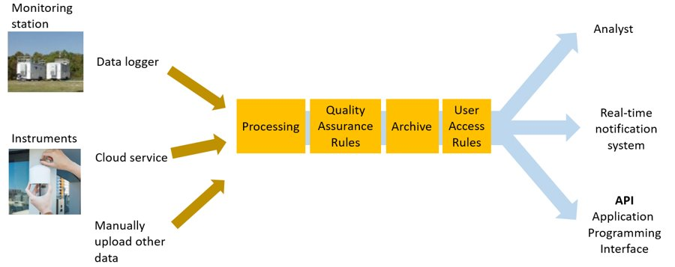
Data Management System Components
Pinder 2021
Notes:
There are many components to a data management system. This includes monitoring stations and instruments, which can have data loggers, cloud services, or this data can be manually uploaded. After the data is obtained, it is processed, checked for QA, and archived. The output of this data can be used by analysts, in real-time notification systems, or accessed through an API.

Slide 6
Air Quality Data Goals
What do you want to do with your data?
  Support compliance with ambient air quality standards
  Evaluate background concentrations and health risks in population centers
  Report air quality to the public
  Support air pollution research

Slide 7
Data Management Goals
Access
Data Quality
Data Security
Public Communications
Fit for Regulatory Determinations
For regulators, analysts, researchers, and the general public​
Important for all objectives​
Ensuring that confidential business information is protected, and data integrity is maintained for all objectives​
Provide real-time and periodic status reports on air quality and progress over time (sometimes through AQI)​
For both emissions limits and ambient air quality standards; requires specificity, comprehensiveness, and representativeness

Slide 8
Principles for Data Handling
Data, once collected, should be stored in a way that can be accessed in the future for a variety of purposes (analysis, communication, time series study, health studies)​
Who and how data is accessed needs to be carefully thought through (balancing goals of communication, data quality, and system security)
Data management systems are desired as a means for achieving these objectives​
  Data storage​
  Data retrieval​
  Data analysis​
  Option to link with meteorological and source activity data​

Slide 9
Data Users
Policy and decision makers​
Analysts​
Quality assurance ​
Institutions and Organizers​
Schools​
Cancellation of outdoor events
Government officials​
Regulatory decisions​
Industries​
Academics and researchers​
Communication with public
People with sensitivity/health conditions
Physicians
Journalists/media
Collaboration
Emissions decisions

Slide 10
What Do Users Need to Know?
How timely do data need to be?​
  Real-time/continuous annual reporting​
How often does the information need to be updated?
  E.g., seconds, hourly​
How precise does information need to be? ​
  Regulatory decisions vs. health warnings​
What can be said about uncertainty? ​
  When are the data reliable?​
  How do we communicate about uncertainty?

Slide 11
Data Management Costs
Expansion of sites, devices, and measures increase cost and staff time​, although there are some economies of scale
More frequent measurements increase data storage and bandwidth requirements​
Less reliable measurements require more quality assurance and analysis time ​
  Calibration and correction factors​
  Criteria for monitoring sites​
  Identification of outliers

Slide 12
Managing Air Quality Data
Data format​
  Labels​
  Units​
  Time stamp​
  Location​
Storage capacity​
Visualization options​
Data communication​
Where are data stored, and who owns the data?​
How to assess data quality and automate quality control​

Slide 13
Data of poor or unknown quality is less useful than no data since it can lead to wrong decisions...
Snyder et al. 2013

Slide 14
Section 2: Best Practices and Validation
1. Introduction
2. Best Practices and Validation
3. Tools
4. Data Gaps

Slide 15
Challenges in Data Quality
Data Quality
Timeliness
Validity
Reliability
Accuracy
Consistency
Completeness
Challenge:
People expect real-time information
Data quality takes time
Solution:
Data validation plan
Clear communication
Notes:
Data quality reflects an array of considerations
Need to balance timeliness with other objectives
Criteria within each objective depend on data quality objectives (DQOs)
e.g., completeness
Accuracy vs Validity
Accuracy vs. Reliability
Consistency vs. Reliability

Slide 16
Why We Validate
Data have real-world consequences
  Decision-making for policy
  Individual decision-making
Ensure data are “fit for purpose” and properly inform decision-making
Prevent issues where possible
Identify and correct issues promptly
Understand impacts of data issues on interpretation and usefulness of data
Build public confidence; improve communication

Slide 17
Data Validation Considerations
Validation is confirmation through objective evidence (i.e., data have passed quality control checks, instruments have passed audits, and the data appear reasonable)
Validating data as soon after collection as practical reduces effort and minimizes data loss
Accurate information helps you respond to community concerns
Serious errors in data analysis and modeling (and subsequent policy development) can be caused by erroneous data values

Slide 18
Best Practices
Use objective evidence to confirm overall validity – instrument audits, technician logs, quality control checks
  Maintain records
Don’t wait to validate – will save time and effort later. Set up a routine – e.g., daily and quarterly checks
Use visual types of analyses – plots, graphs, maps, not just spreadsheets or automated rules
Consider data in context, both spatial and temporal
Adhere to SOPs
Regularly evaluate instruments
Be critical, but consider that the unusual or unexpected could be valid

Slide 19
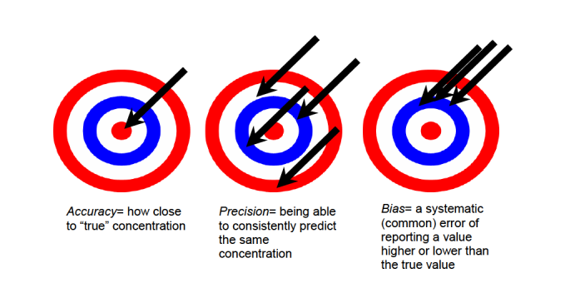
Accuracy, Precision, and Bias of a Sensor
https://cfpub.epa.gov/si/si_public_record_report.cfm?Lab=NERL&dirEntryId=277996&simpleSearch=1&searchAll=air+sensor+guidebook

Slide 20
Possible Sources of Error
Instrument
Environment
Human error

Slide 21
Data Validation Levels
Level 0: Routine checks
  Field operations, data processing, reporting conducted in accordance with standard operating procedures (SOPs)
  Proper data file identification, review of unusual events, field data sheets, instrument performance checks
Level I: Internal consistency tests
  Identify values that appear atypical when compared to values of the entire dataset
Level II/III: External consistency tests
  Identify values that appear atypical when compared to other datasets
  Continued evaluation of the data as part of the data interpretation process
http://www.epa.gov/ttnamti1/files/ambient/pm25/spec/specfinl.pdf

Slide 22
When to validate?
Daily checks
  Changes in instrument status – healthy, needs attention, offline?
  Check reasonableness of data
    Within expected range
    Spatial and temporal patterns
    Flag data if needed for more analysis
Monthly checks
  Time series (weekly and monthly)
  Operator logbooks
  Scatter plots
  Summary statistics
Notes:
Check regularly and often!

Slide 23
What to Look for in Validation
Outliers, negative values
Magnitude of values
Missing data, no signal
Flat signal, constant values (“stickiness”)
Noisy data or rapid changes
Drift

Slide 24
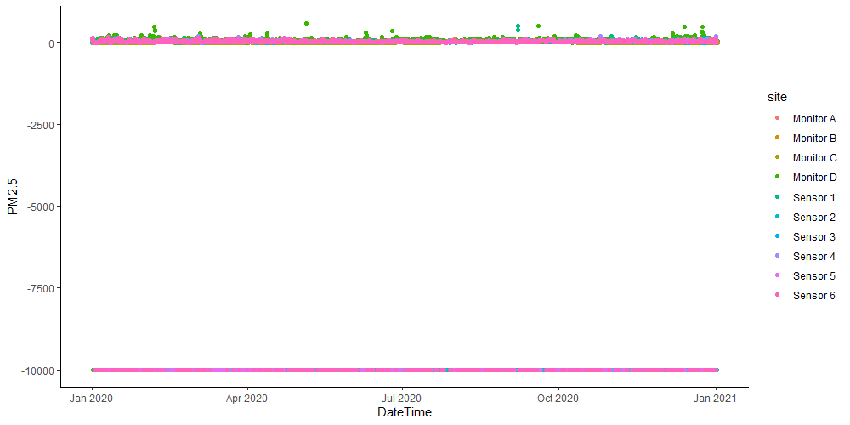
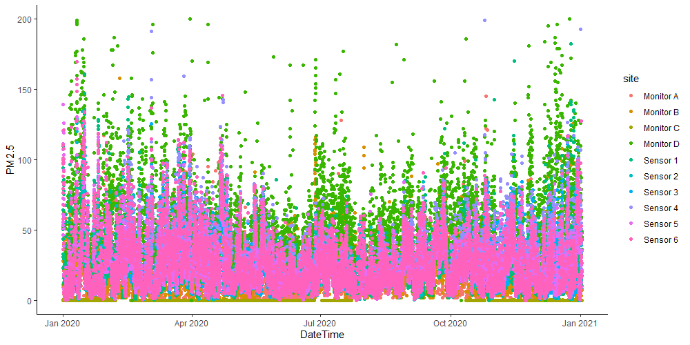
Example Data
Very Low Concentrations
Negative Values
Data Gaps
Notes:
These two graphs show examples of things to look out for when visually exploring data for validation. This can include negative values, as well as data gaps, or especially low concentrations.

Slide 25
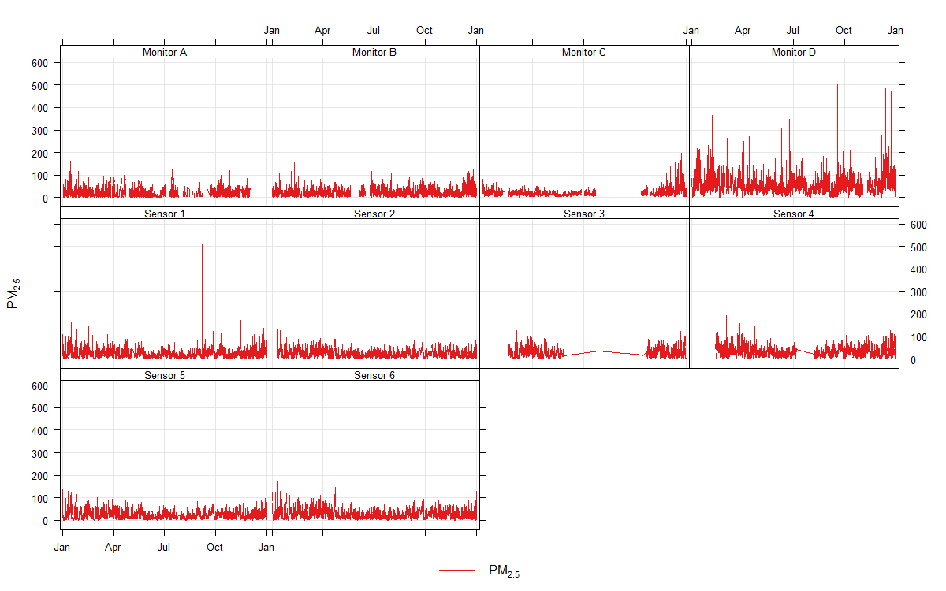
Example Data
Large gaps in example data
Notes:
This figure shows PM2.5 data over time, with the green boxes showing large gaps in the example data, which is something to look out for in data validation.

Slide 26
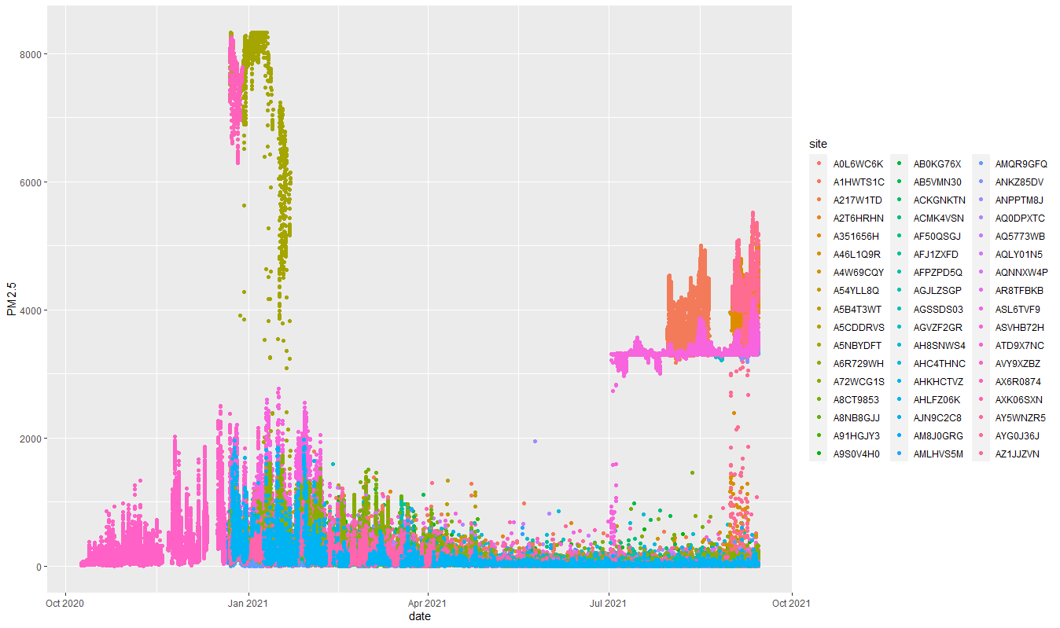
Example Data
Outliers/ changes in magnitudes
Flatlining
Very Low Concentrations?
Difficult to determine with current y-axis scale
Data Gaps
KHM Clarity Sensor data pre-cleanup
Notes:
Again, this figure depicts different patterns to watch out for when visually inspecting data for data validation. This includes data gaps, flatlining, and outliers.

Slide 27
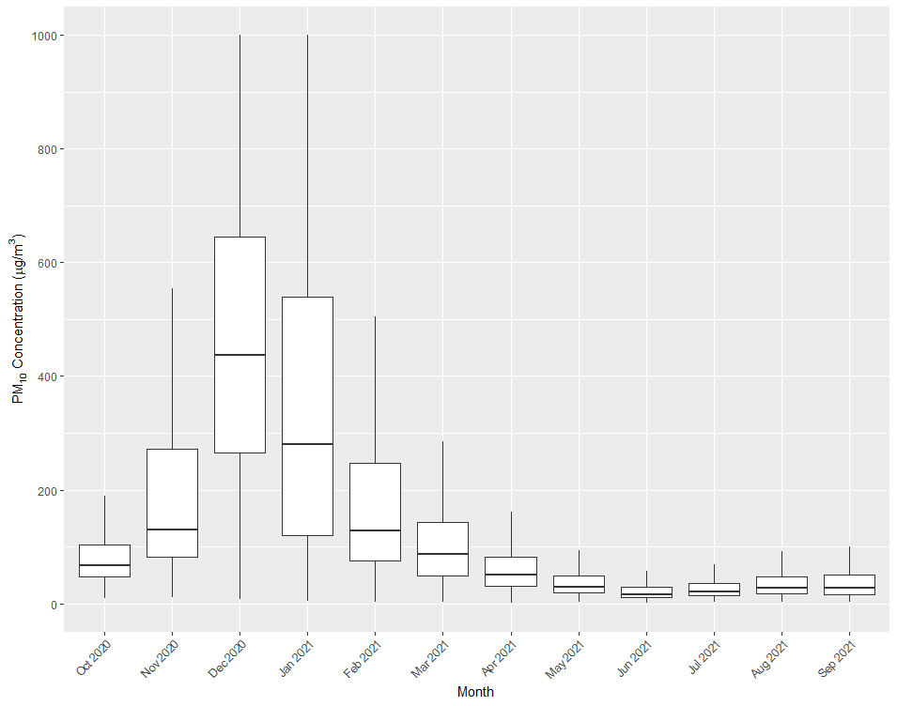
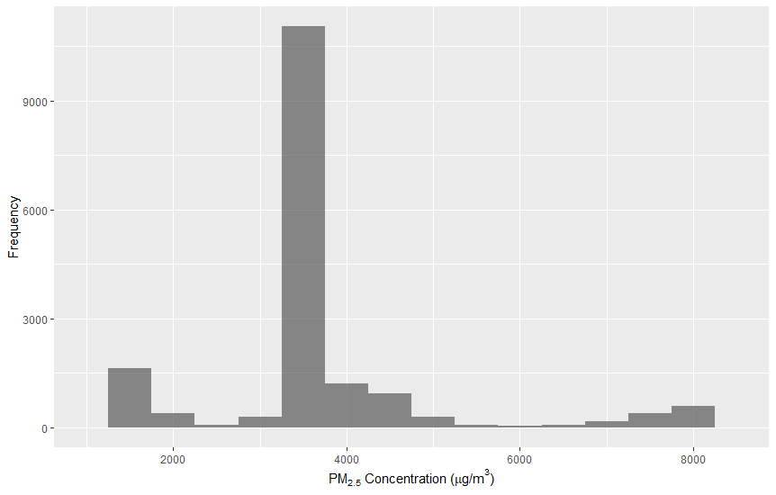
Types of Visual Checks
Scatter plots
Time series (3-5 days at least)
Mapping
Box and whisker plots
Histograms
Comparing related sites or instruments
Compare across pollutants

Slide 28
Visual Review Considerations
Are concentrations consistent with time of day, day of week, season, and other pollutant concentrations?
Are peak or low concentrations occurring where and when they are expected?
Do concentration spikes or dips correspond with those of other pollutants? Are they consistent with meteorology (e.g., changes in wind direction or wind speed)?
Are spatial patterns of concentration as expected (e.g., one site typically experiences higher concentration than another)?
Do baseline concentrations remain stable over time?

Slide 29
Overview of Quality Control Approach
Explore data: sort it, graph it, map it
Perform spatial and temporal comparisons of data
Compare data between instruments
Set up automated QC checks in your data management system
Notes:
Set up automated QC checks in your data management system
Range checks: minimum and maximum concentrations
Rate of change or spike check
Buddy site check: comparison to nearby sites
Sticking check: consecutive identical data values (applied for concentrations above the limit of detection)

Slide 30
Daily Quality Control Actions
Daily review of data ensures proper operation of deployed instruments
First identify that operations are stable
Take action if there is missing or odd data
Review whether concentrations are reasonable compared to other sites
Notes:
“Are all instruments operating?” is designed to quickly identify both stable, proper operations and unstable, improper operations
If there is missing data, or the data look odd, you can then take action
Once it is clear that instruments are operational, it is important to review whether the pollutant concentration patterns are reasonable for the time of day, season, meteorology, and patterns observed at other sites
If anomalies are observed, conduct additional analysis to determine if there is an instrument malfunction

Slide 31
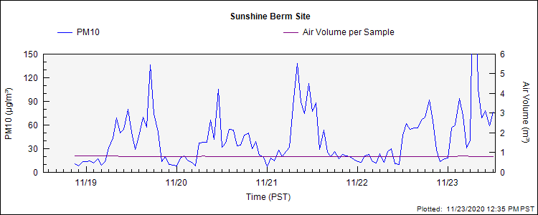
Weekly Visual Data Review
Typical review consists of 3-5 day running time-series plot to look for common problems and determine that instruments are operational
Look for data gaps and issues that require attention in the field
Depending on the complexity of the data and number of sites, this review can typically be performed in a few minutes

Slide 32
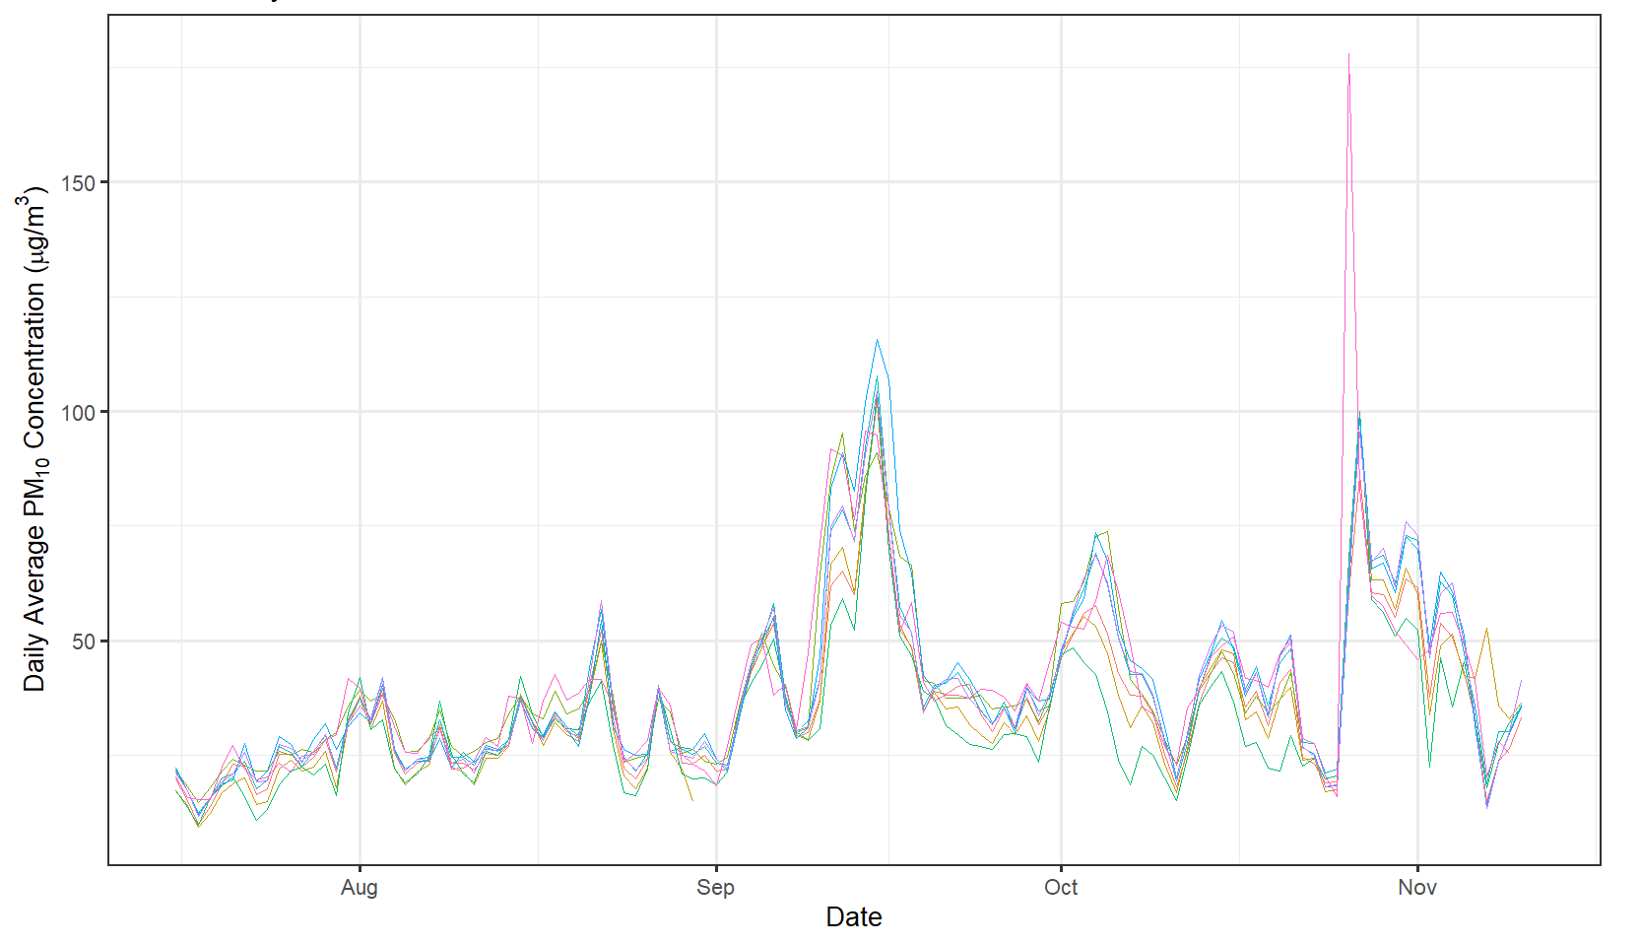
Monthly Visual Data Review
Focus on patterns – diurnal and spatial – to verify that data are reasonable
Common plots and data summaries:
  Scatter plots
    Are pollutant concentration relationships as expected?
  Summary statistics
    Are concentration ranges and peak values within typical levels for the site?
  Time series: Do concentrations vary as expected?

Slide 33
Importance of Documentation and Logbooks
Logbook entries, notes, and calibration information should be kept up-to-date by the station operators

Slide 34
Data System Considerations
Streaming data ingest and storage​
  In-house database​
  Cloud/application solution​
Computing/storage capacity​
Security, backups, recoverability​
Automation​
  Ingestion of data and fast processing​
  Auto-screening​
  Alerting for missing data​
Careful database planning​
  Metadata​
  Scalability​
    Adding monitors​
    Expanding to multiple pollutants​
  Data flow and processes​
  Long term IT support and maintenance (how system will run for 5+ years)
Plan for using the data after collection​
  Data access and web services​
  Getting the data out of the system (for decision/policy makers and the public)

Slide 35
Challenges in Messaging
Concentrations vs. Air Quality Index (AQI)​
  Concentrations may be hard to understand for the public​
  AQI allows one message for multiple pollutants (colors)​
Short-term data – what does it mean?​
  Health studies are usually based on longer time exposures​
  EPA is conducting research into appropriate messaging for short-term data​
  Linking observations to who should be concerned and what actions to take​
Observation
Data
Information
Action

Slide 36
Summary
Data management is a critical ongoing activity in AQMP development and evolution
Many issues need to be thought through, and continuity of effort is critical
  It is imperative to first establish the lead institution(s) who will “own” and maintain data and the management system
Many resources are available internationally

Slide 37
Section 3: Tools
1. Introduction
2. Best Practices and Validation
3. Tools
4. Data Gaps

Slide 38
Options for Air Monitoring Data Management
Monitoring data can be generated in enormous quantities with modern monitors, so a data management system quickly becomes a requirement
Two commonly used options:​
  AirNow: U.S. EPA product, supported by contractors, used for U.S. Embassy monitors and many international networks​
  AIRVIRO: commercial product, being used by the countries of Chile, Estonia, and Singapore, among others​

Slide 39
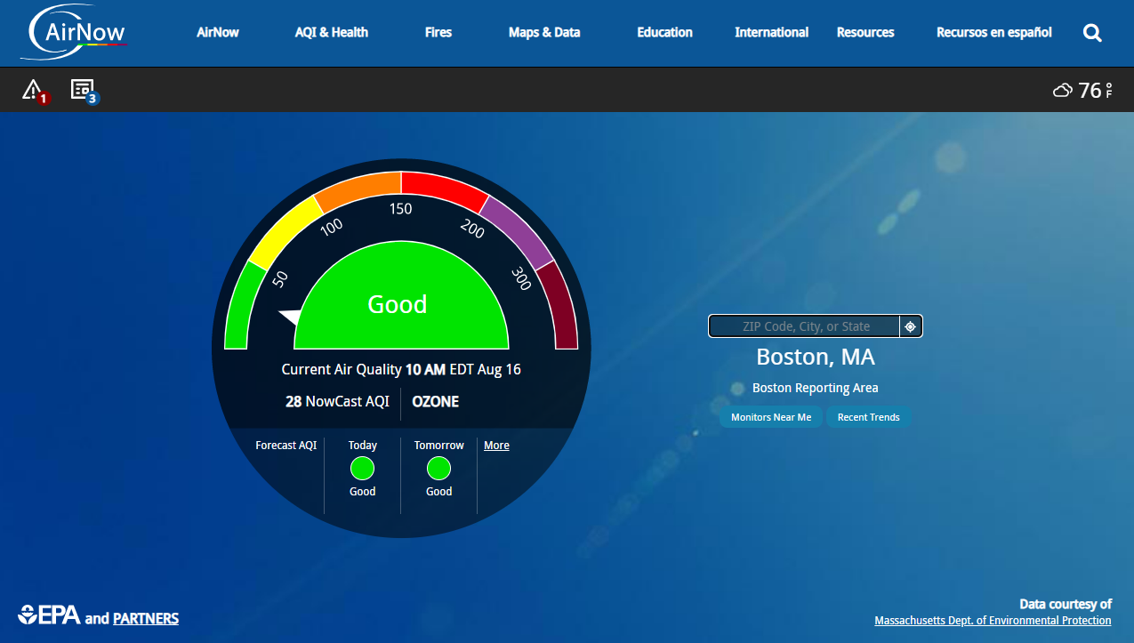
AirNow
Gathers and quality assures data provided by 150+ federal, state, tribal, and local air quality agencies
Real-time and forecasted air quality information to the public
Educates public on air quality and health
Includes data for Canada, Mexico, as well as U.S. Embassies and Consulates
https://www.airnow.gov/

Slide 40
How is AirNow used?
AirNow technology available to all users
Countries can add data into AirNow and utilize existing services and tools
  Format dataset into AQSCV and flow via FTP
  Provide open access to your dataset; AirNow can access data
  OR:
Install/implement the software locally
  Requires more IT effort and expertise
  Full configuration of the AirNow system in-country possible
    Resources required for technical training to local staff for system operations and implementation

Slide 41
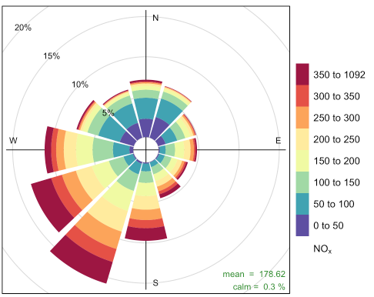
Open-Source Tool: openair
Length: How often does the wind come from this direction?
Colors: What is the concentration when the wind comes from this direction?
https://bookdown.org/david_carslaw/openair/sec-windRose.html

Slide 42
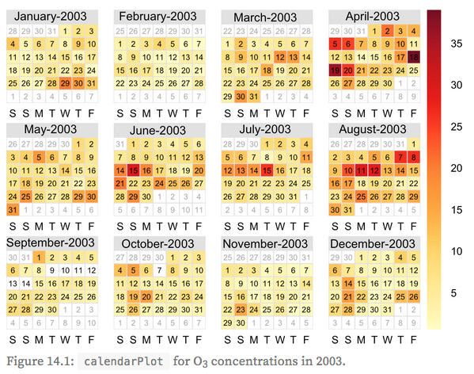
Open-Source Tool: openair
https://bookdown.org/david_carslaw/openair/sec-calendarPlot.html#calendar-examples

Slide 43
openaq
Programmatic, transparent access to historical station AQ data in a universal format:
  PM₁₀, PM₂.₅, BC, O₃, CO, NO₂, SO​₂
  Primarily gov’t sources​
  >75 million total measurements, ~200,000 added daily​
  5600+ monitored stations in 48 countries​
  Data accessible via API, csv files, user-customized files via openaq.org

Slide 44
Section 4: Data Gaps
1. Introduction
2. Best Practices and Validation
3. Tools
4. Data Gaps

Slide 45
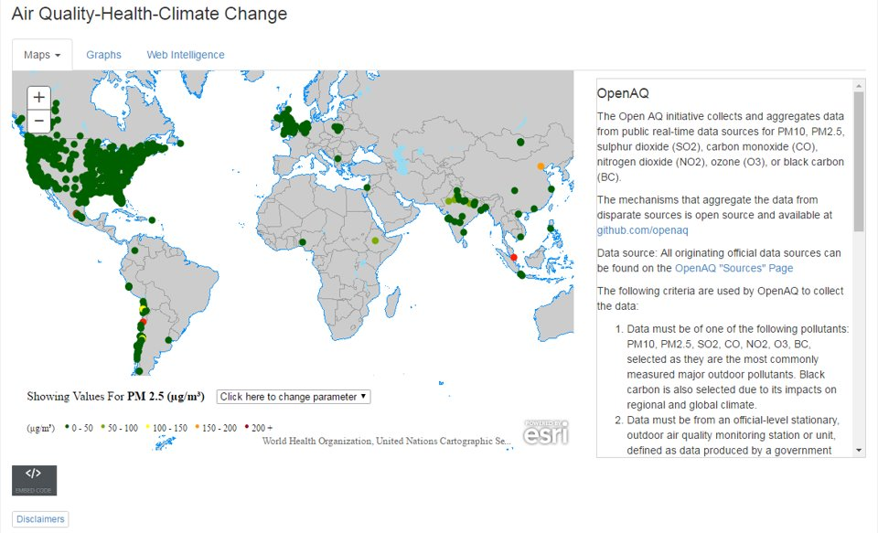
Currently Available Air Quality Data
Large gaps in air quality data exist!
Environment Live

Slide 46
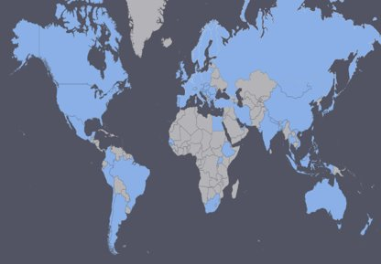
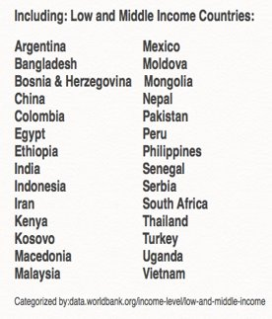
Geography Gap
Approximately 70 countries share near real-time AQ data in some form

Slide 47
Bridging the Accessibility Gap
Disparate public AQ data collected across the world
Open, transparent, accessible universal data layer
Ground-truthing low-cost sensors, incorporating data with AOD and forecasting
Public engagement (e.g., apps, bots)
Public Health Policy and Analysis
Media
Educational Activities

Slide 48
Thank you!

